Slide 1
.NET
Final-term
Virtual House WebAPP based on Virtual-Real Fusion
1452712 王家慧

Slide 2
CONTENTS
01
Project Overview
02
Key Algorithm
03
Realize & Explore
04
Future Prospect

Slide 3
01
Project
Overview

Slide 4
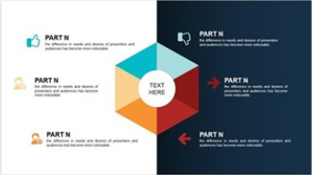
现有线上交易平台
PART ONE Background
销售业绩下滑
形象扁平
产能过剩
实物与图片差别大
行业背景
卖场层层盘剥
试用退换货代价高
直观、真实可感
便宜、方便快捷
Notes:
横向对比 —— 传统线下家具销售。尽管直观……，
纵向对比 —— 现有线上交易平台（网店）。

Slide 5
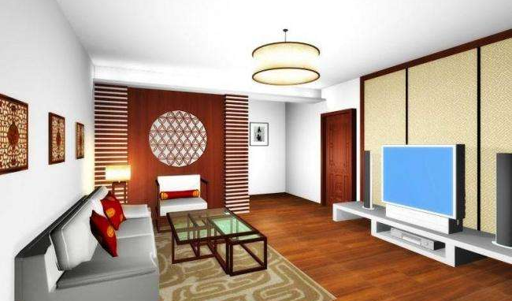
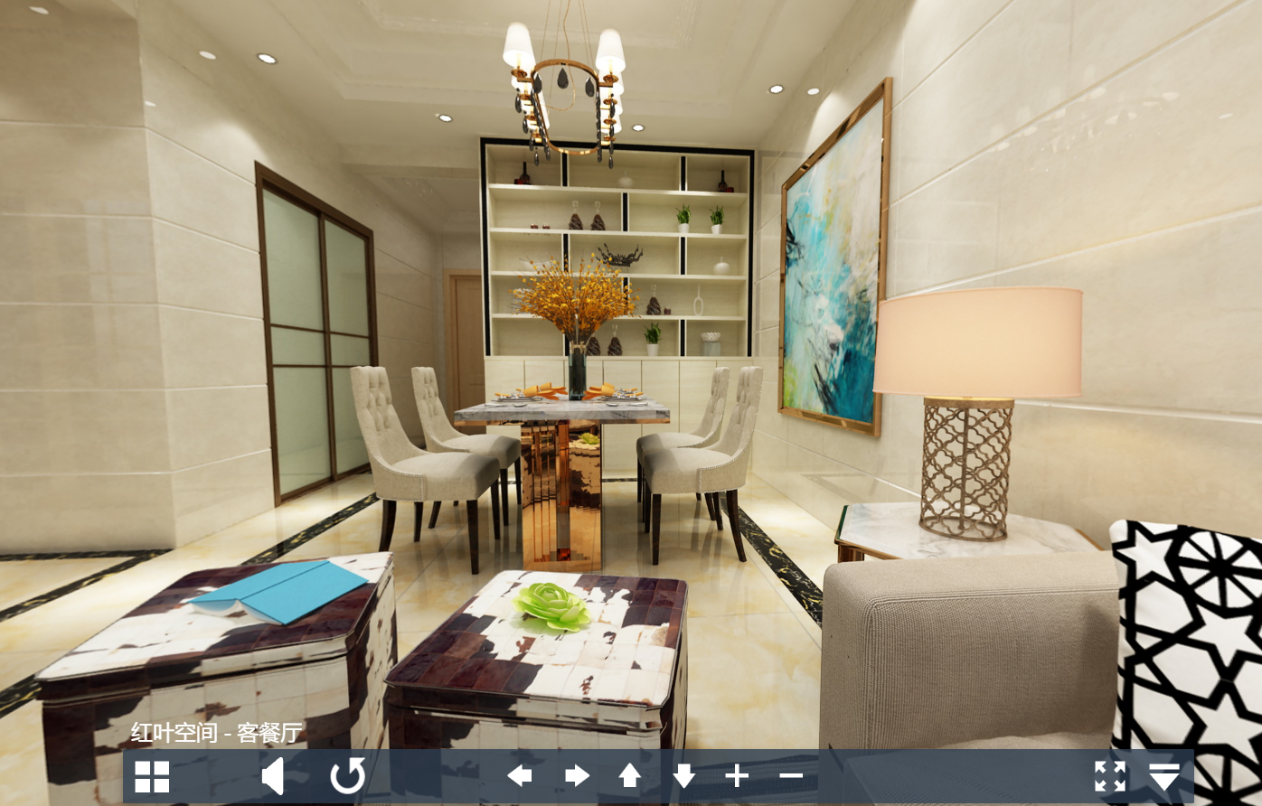
PART ONE Background
Virtual home
Pure 3D modeling
Interior scene reconstruction based on real picture
Notes:
由于素材源自于现实世界且交互基于真实场景，故该算法能够有效地提高虚拟家居展示的真实性，使用户交互具有极强的真实感。同时，由于图像素材丰富、获取容易，在一定程度上克服了纯3D技术渲染速度慢、模型制作复杂等缺点

Slide 6

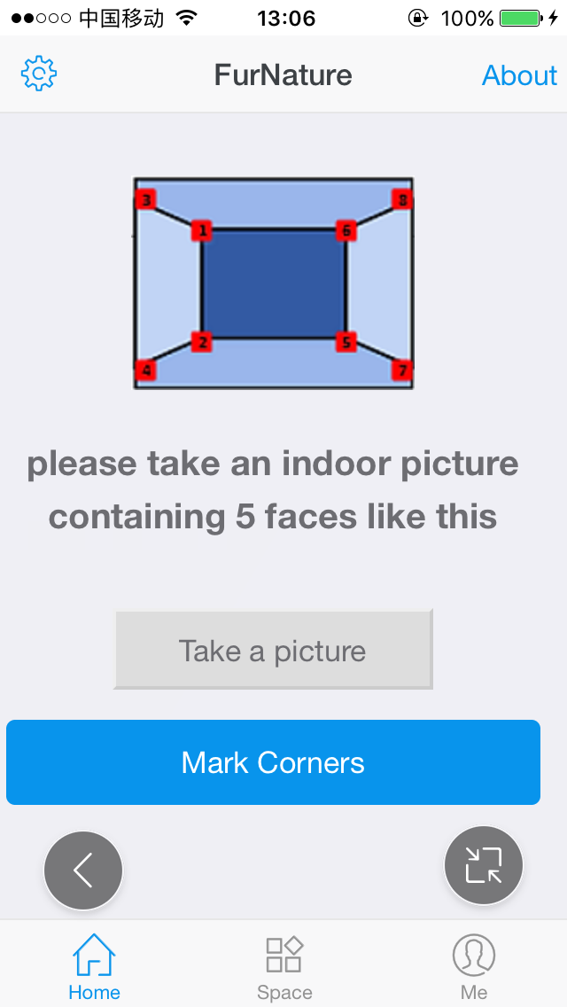
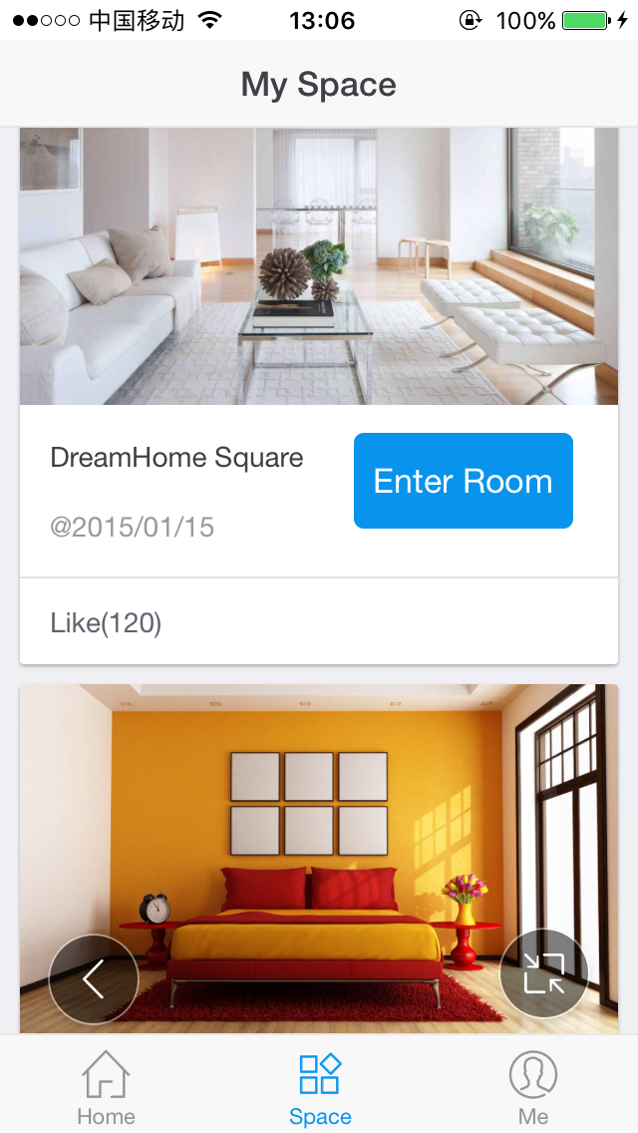
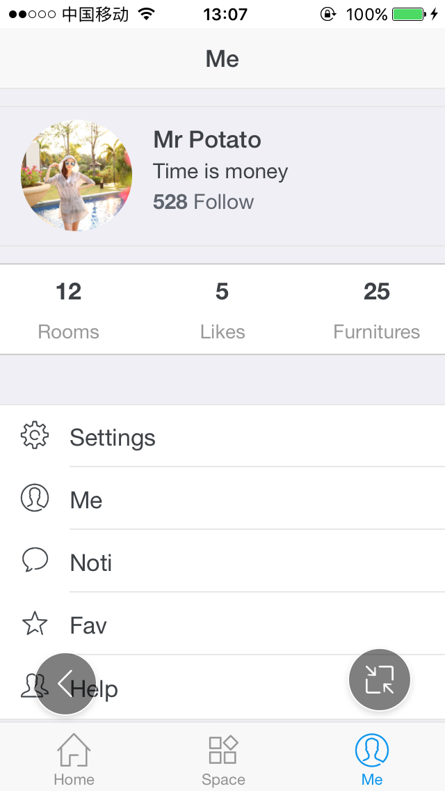
PART ONE Product
Home
Space Display
User Info
Management
Open WebAPP FurNature
Take an indoor picture using your mobile phone
Reconstruct interior
scene automatically
Notes:
由于素材源自于现实世界且交互基于真实场景，故该算法能够有效地提高虚拟家居展示的真实性，使用户交互具有极强的真实感。同时，由于图像素材丰富、获取容易，在一定程度上克服了纯3D技术渲染速度慢、模型制作复杂等缺点

Slide 7
PART ONE Development
Browser:
Html5+CSS3+JS
& Three.js
Image recognition:
OpenCV
WebAPP
WebAPP
Net: Java
Database: MySQL

Slide 8
02
Key
Algorithm

Slide 9
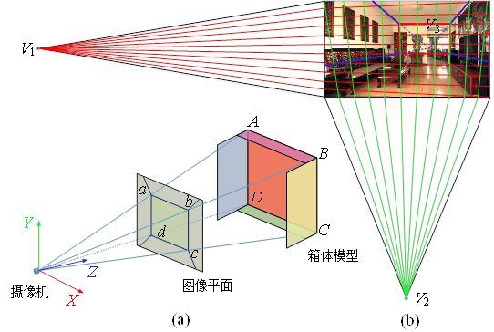
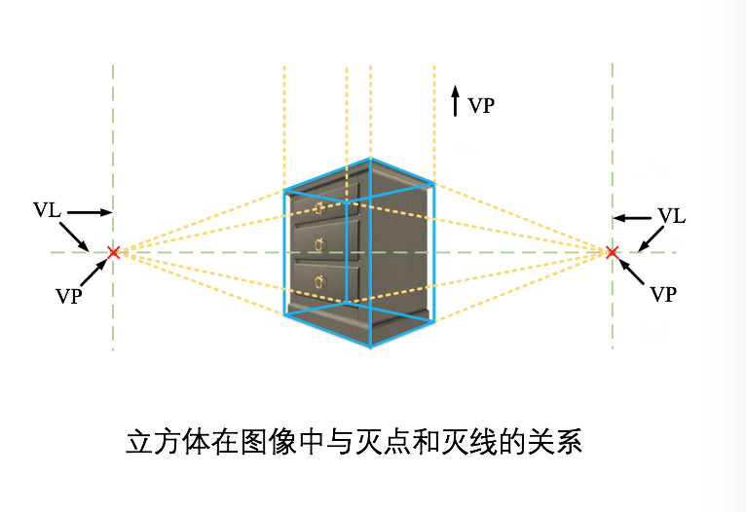
PART TWO Theory
What is Vanishing Point?

Slide 10
PART TWO Algorithm
1
2
3
Compute
intersections
of lines
Vanishing
point voting
Edge detection
How to detect Vanishing Points?
Notes:
单张复杂室内图像的灭点检测

Slide 11
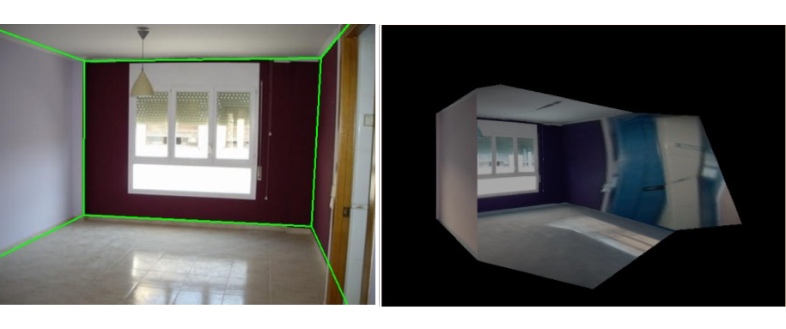
PART TWO Algorithm
1
2
3
Divide faces based on vanishing points and 4 corners
projective
Transformation &
Box reconstruction
Detect
corners
How to reconstruct interior scene ?

Slide 12
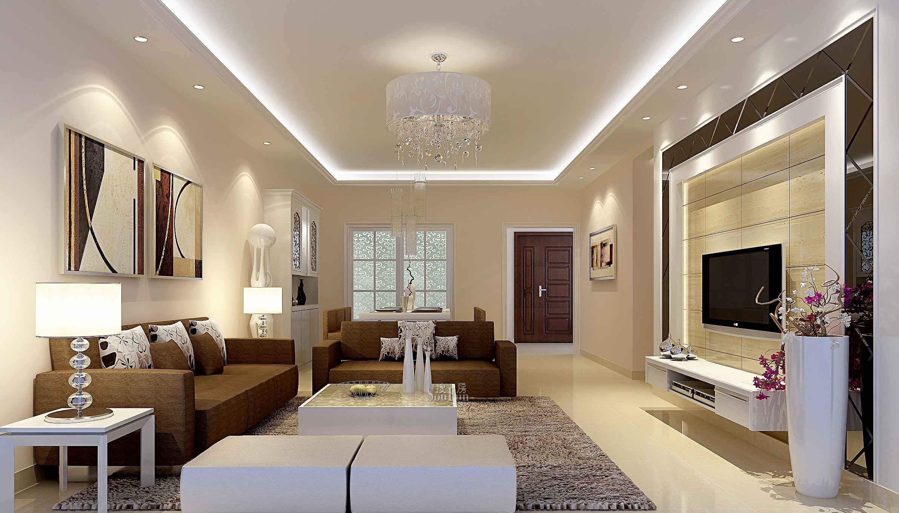
PART TWO Algorithm
Notes:
单张复杂室内图像的灭点检测

Slide 13
PART TWO Algorithm
Notes:
单张复杂室内图像的灭点检测

Slide 14
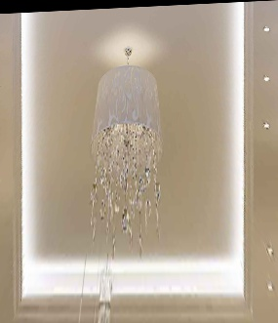
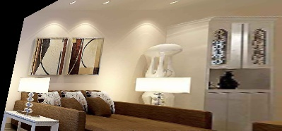
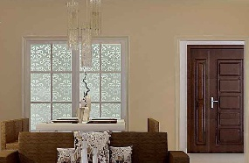
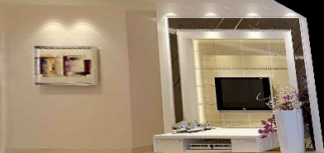
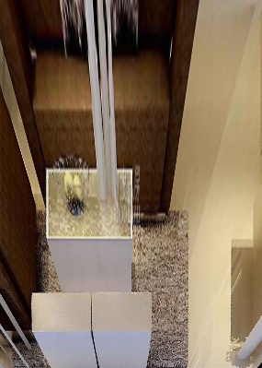
PART TWO Algorithm
Notes:
单张复杂室内图像的灭点检测

Slide 15
03
Realize &
Explore

Slide 16
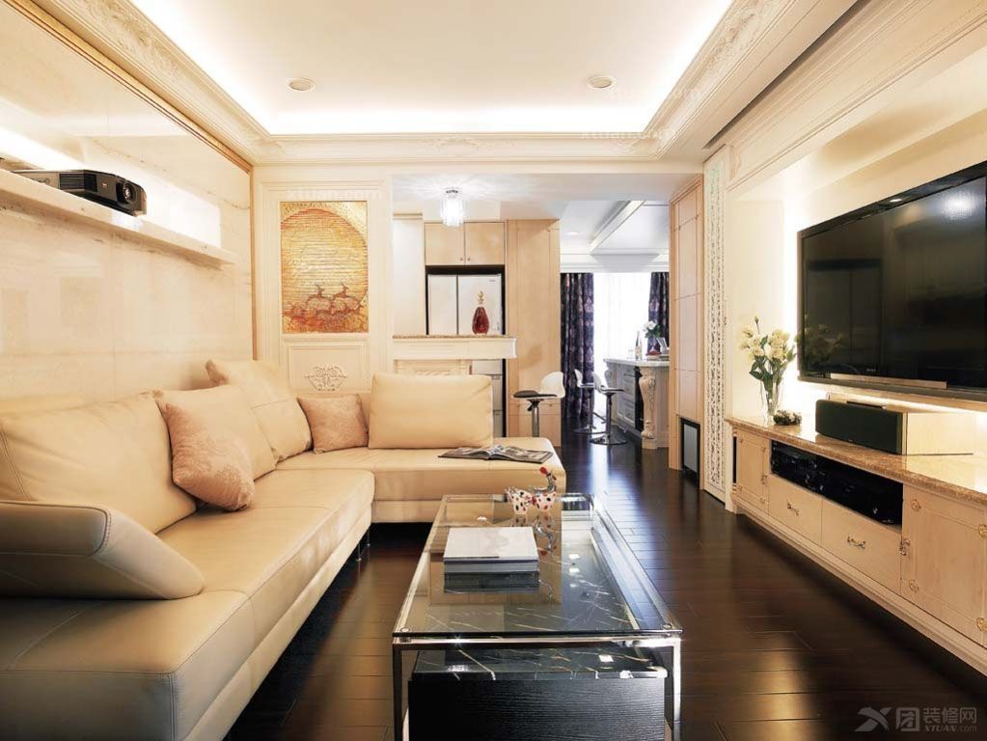
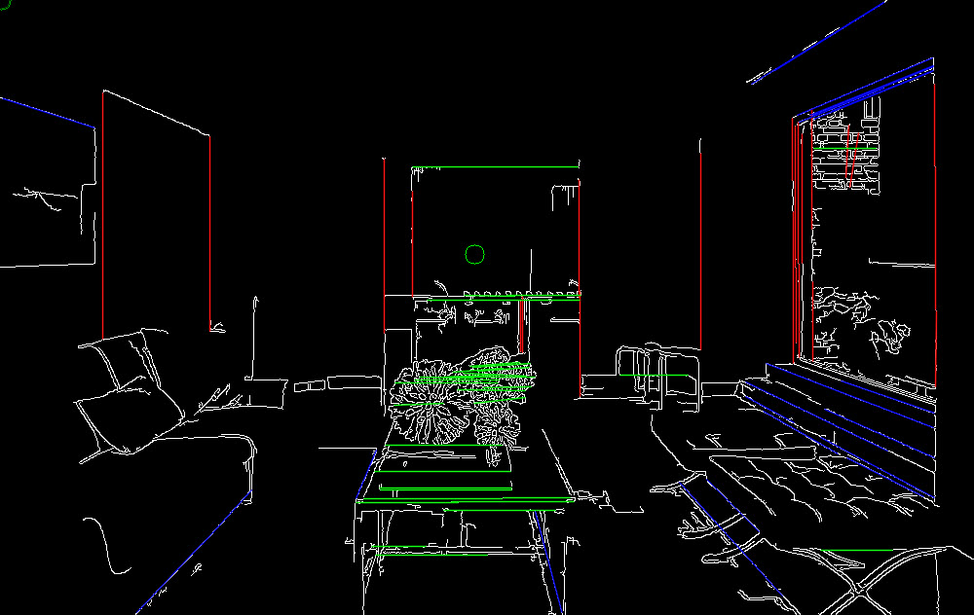
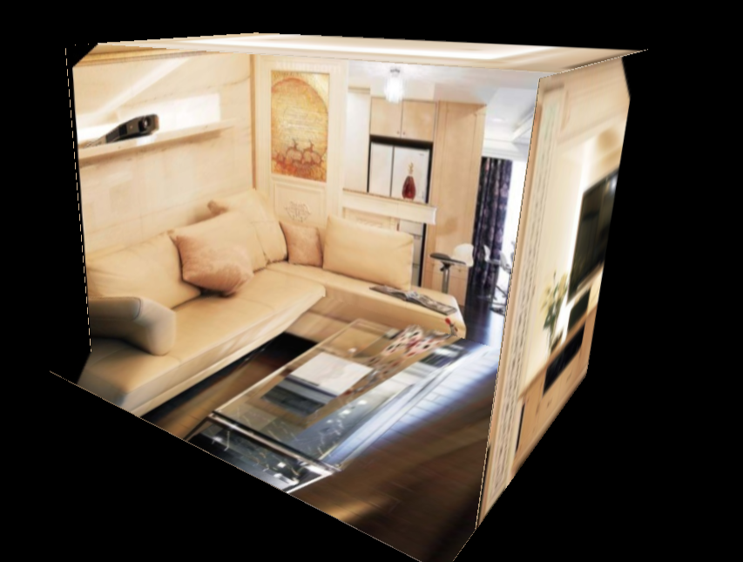
PART THREE Progress
1
2
3
Manual corner selection for construction
Implementation vanishing point detection
reconstruction
algorithm based on
vanishing point

Slide 17
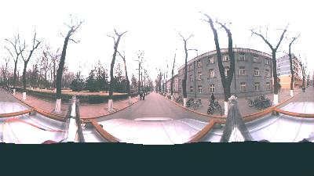
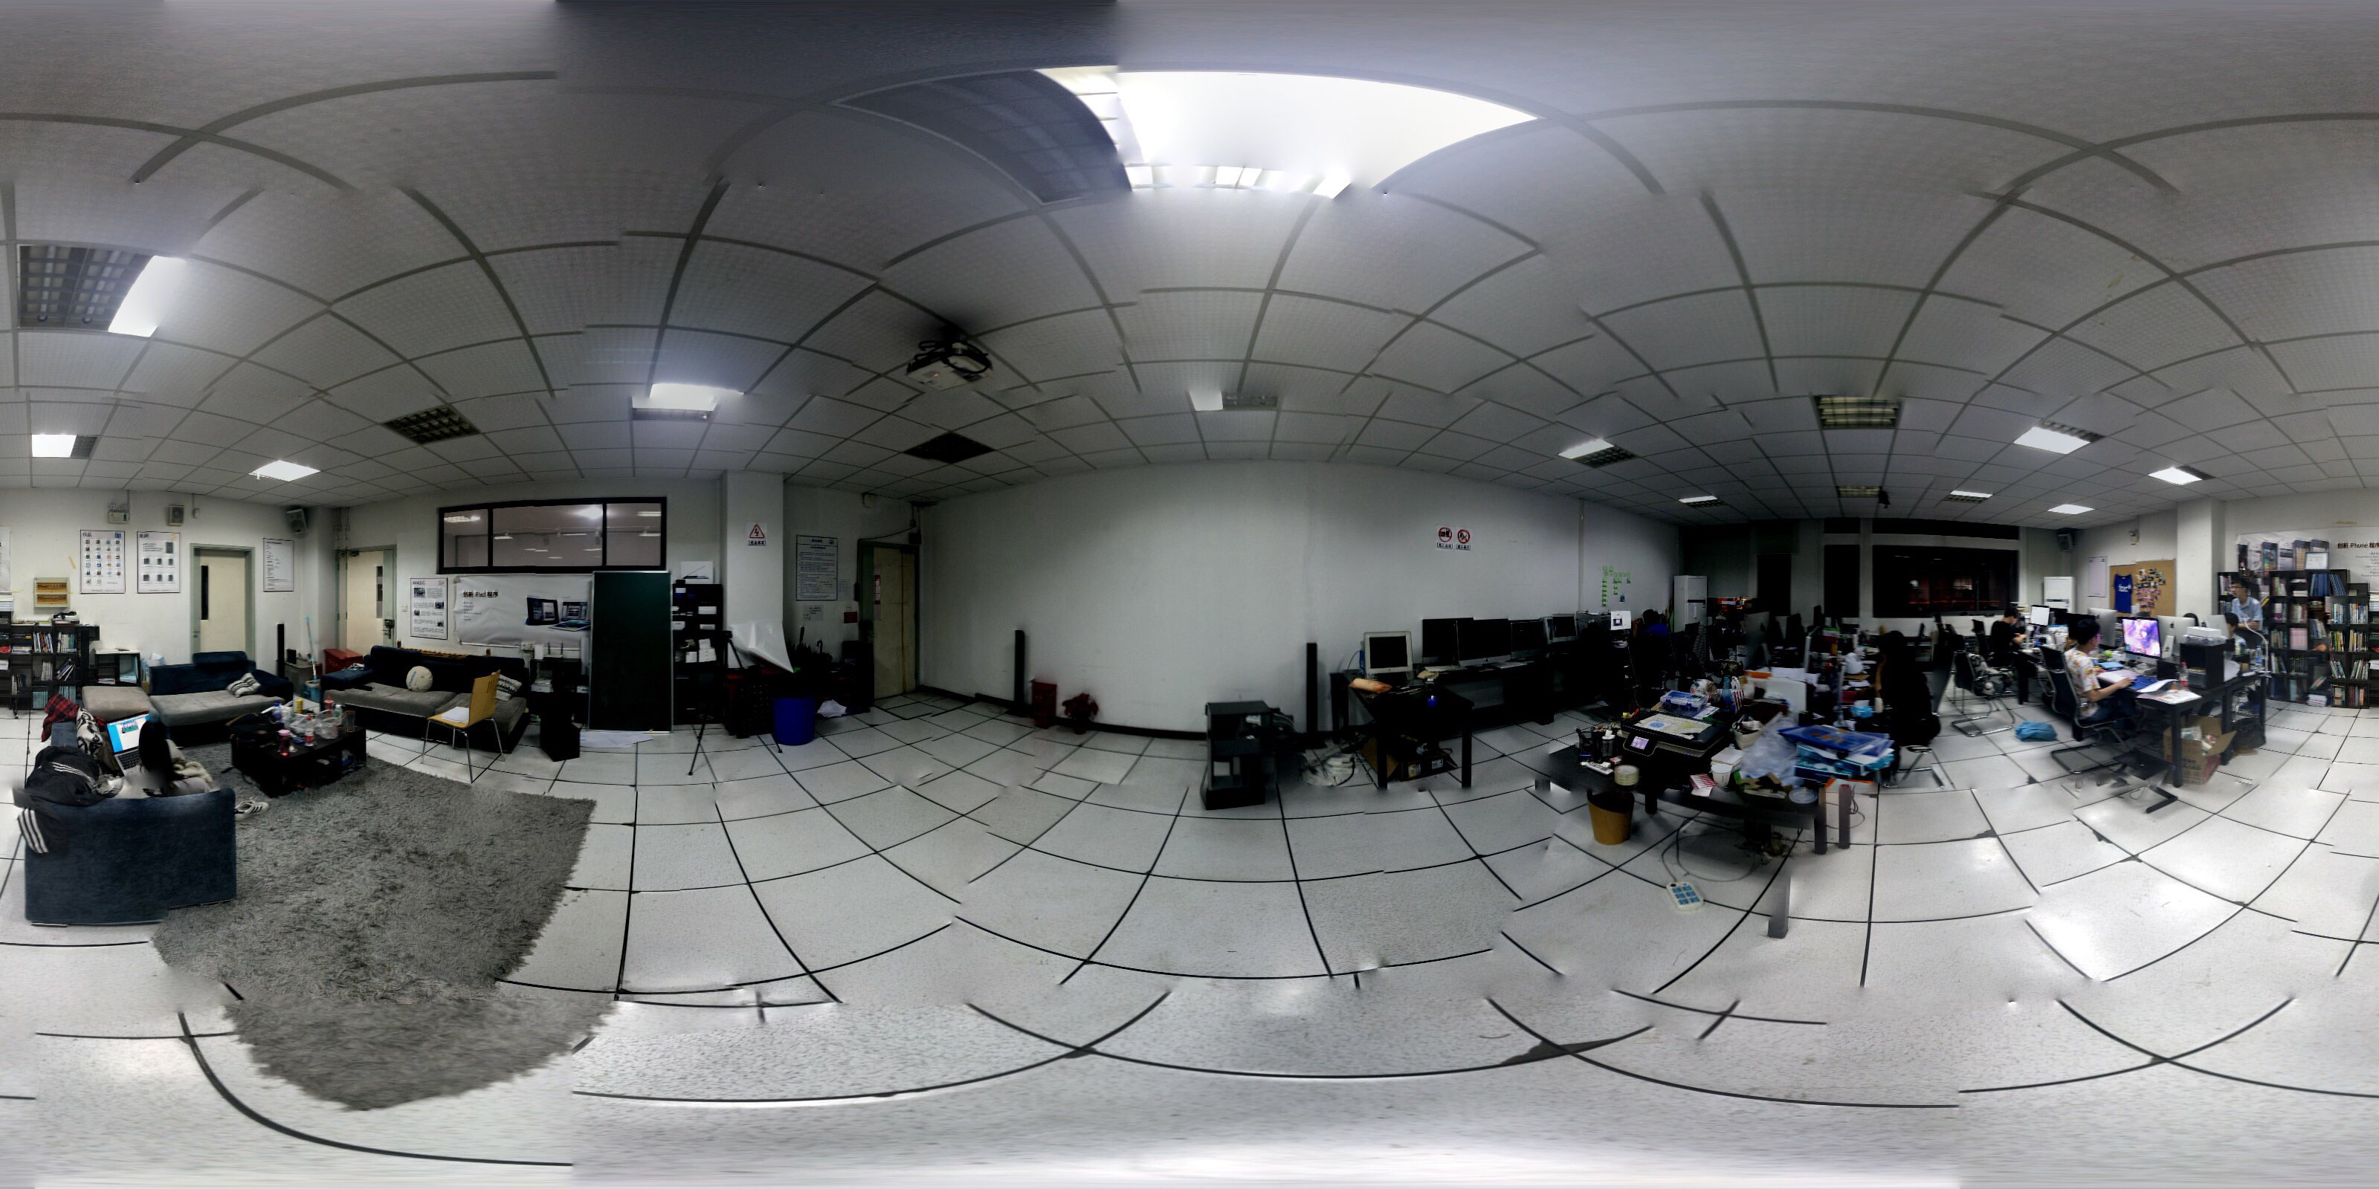
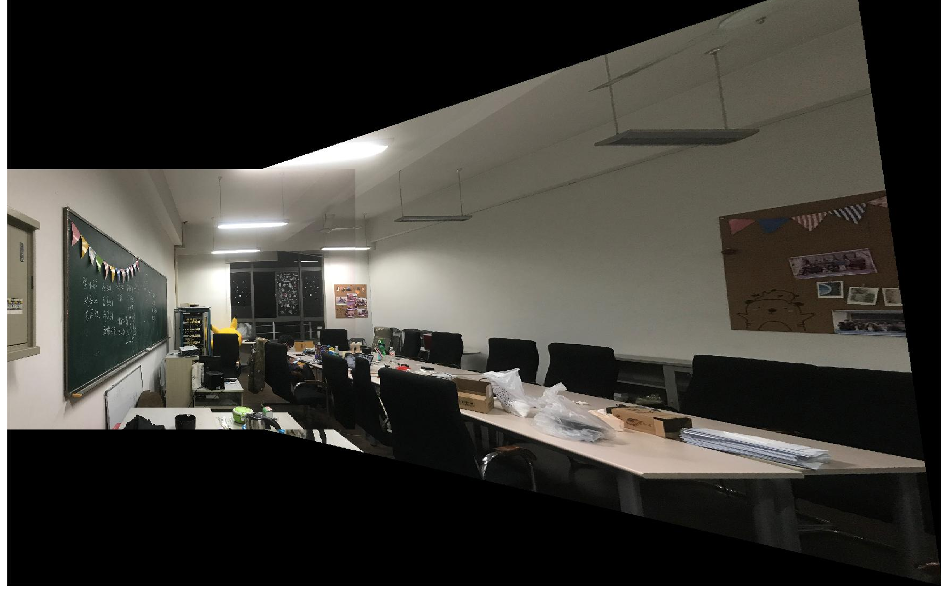
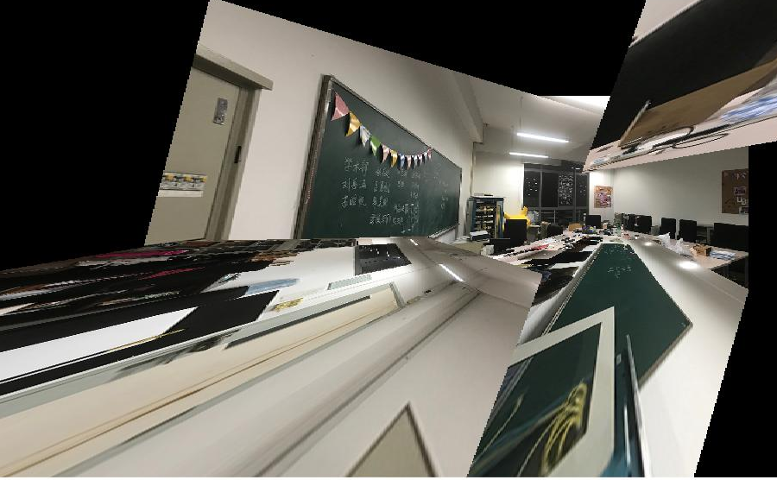
PART THREE Panorama
Sphere to cube
Panorama by mobile phone camera
Panorama by apps
Panorama by stitching

Slide 18
PART TWO Algorithm
1
2
3
Select corner by machine learning
Select corner point semi-automatically
Select corner manually
Notes:
单张复杂室内图像的灭点检测

Slide 19
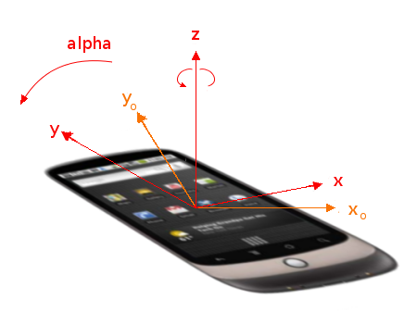
PART THREE Exploration
Explore the possibility of natural interaction：
Guarantee objects parallel to the viewing angle;
Simulate human’s perspective of the move;
Three.js + Gyro Sensor：
DeviceOrientationControls.js
Explore the possibility of virtual tour：
Make the picture further or closer while wandering
Change view of respect by rotation
Notes:
探究自然交互的可能：
1）旋转手机，物体随之旋转，保证与视角平行；
2）前后左右平移手机，模拟人视角的移动；
探究虚拟漫游的可能：
1）前后走动，画面也拉近拉远；
2）左右旋转，转换观看室内视角；

Slide 20
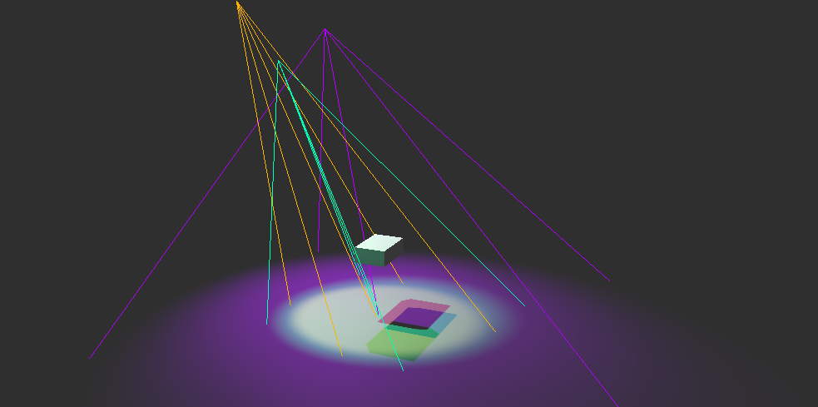
PART THREE Exploration
Learn about spherical harmonics lighting：
Try to realize three light source control ：
Notes:
webGl的实现过于复杂，特别是交互方面，因此在尝试用webGL实现后，借助three.js简化实现。three.js是对webGL诸多矩阵设置、接口调用的一次封装，尽管功能不如原生JavaScript自带的webGL强大，但基本能满足我们的需求。

Slide 21
04
Future Prospect

Slide 22
PART FOUR Prospect
Intelligent interaction ：
User can select a piece of furniture, drag into the scene and decide to remove it or not

Slide 23
PART FOUR Prospect
Photographic Analysis and Background Reduction of Image Scene ：
We extract light information from the background

Slide 24

THANK YOU !
Team Members
周同 储港 王家慧 吴书涵

